Slide 1
Development of a Research Database for the
Presented by Jennifer Greene, PhD, Melissa Messer, MHS, and Sue Trujillo, MS

Slide 2
Personality Assessment Inventory (PAI)
The PAI is a self-administered objective measure of adult personality (Morey, 1991)
Widely used as a clinical and research tool
Consists of 344 items within 22 nonoverlapping scales

Slide 3
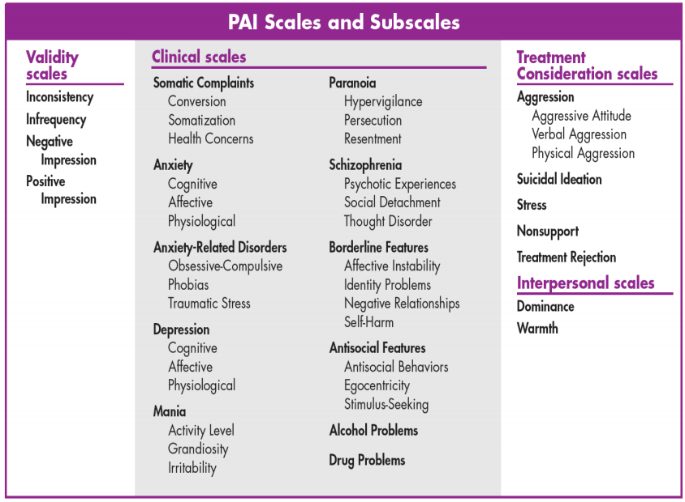
Notes:
Broad-based: four validity scales, 11 clinical scales, five treatment scales, and two interpersonal scales

Slide 4
Purpose
Explore the nature and scope of research that utilized the PAI during the last three decades
Describe the creation of a comprehensive list of research references that can be easily accessed by researchers and clinicians

Slide 5
Methods
The PAI author identified research studies that were about or used the PAI. These include:
Peer-reviewed journal articles, theses, dissertations, and conference presentations
References were imported into Mendeley, a reference management software program.
Free to use by creating an account at mendeley.com (see handout for instructions)

Slide 6
Methods – Coding
References were divided into several broad categories:
Personality disorders
Psychopathology
Acquired or developmental disorders
Within each broad category, references were tagged by subject using author keywords and relevant terms from the title and abstract
For each broad category, the frequency of references was examined
Notes:
Since putting together this presentation, we’ve also added other codes from Morey’s original list, such as codes for when the article includes information or data on a particular PAI scale

Slide 7
Results
1,241 references were identified
Of those, 976 were coded into one or more broad category
(n = 333)
(n = 556)
(n = 87)

Slide 8
Personality Disorders
Cluster A
Odd, eccentric, or bizarre behavior Paranoid, schizotypal, and schizoid personality disorders
Personality disorders were tagged according to Section II diagnostic codes from the DSM-5.
Cluster B
Dramatic, emotional, and/or erratic behavior Borderline, antisocial, narcissistic, and histrionic personality disorders
Cluster C
Characterized by anxiety and fearfulness Avoidant, dependent, and obsessive–compulsive personality disorders
Notes:
Personality disorders are grouped into clusters based on descriptive similarities.
For Cluster B: Although not categorized as a personality disorder, we also tagged studies of psychopathy given the term’s relationship to antisocial personality disorder.

Slide 9
Personality Disorders
(n = 11)
(n = 307)
(n = 15)
n = 333 studies
Notes:
Most studies (92.2%) were related to Cluster B personality disorders

Slide 10
Cluster B
(n = 160)
(n = 76)
(n = 68)
(n = 3)
Notes:
Within Cluster B, borderline personality disorder was most commonly studied (52.1%), followed by antisocial personality disorder (24.8%), and the related psychopathy category (22.1%);
There were no studies related to histrionic personality disorder.

Slide 11
Cluster A
(n = 10)
(n = 1)
Notes:
The most commonly studied Cluster A personality disorder—by far—was paranoid personality disorder (90.9%), with only 9.1% of studies related to schizotypal personality disorder and no studies related to schizoid personality disorder.

Slide 12
Cluster C
(n = 7)
(n = 1)
(n = 7)
Notes:
The most commonly studied Cluster C personality disorders were avoidant (46.7%) and obsessive–compulsive personality disorders (46.7%).

Slide 13
Psychopathology
Internalizing | Anxiety Depression Suicide/suicidal ideation | Social Anxiety Panic disorder PTSD Eating disorders
Externalizing | Addiction Aggression Alcohol abuse | Substance abuse Mania Gambling disorder
Reality-Impairing | Grandiosity Paranoia Psychosis | Schizophrenia Somatoform disorders

Slide 14
Psychopathology
n = 556 studies

Slide 15
Internalizing Domain
(n = 57)
(n = 94)
(n = 41)
(n = 7)
(n = 7)
(n = 42)
(n = 23)
Notes:
Depression, anxiety, PTSD, and suicide were the most commonly studied within internalizing domain

Slide 16
Externalizing Domain
(n = 4)
(n = 103)
(n = 42)
(n = 59)
(n = 6)
(n = 4)
Notes:
Aggression, and alcohol/substance abuse were the most commonly studied within externalizing domain

Slide 17
Reality-Impairing Domain
(n = 3)
(n = 5)
(n = 7)
(n = 33)
Notes:
schizophrenia was the most commonly studied reality-impairing disorder

Slide 18
Acquired or Developmental Disorders
(n = 22)
(n = 2)
(n = 47)
(n = 16)
n = 87 studies
Notes:
Traumatic brain injury and attention-deficit/hyperactivity disorder were the most commonly studied acquired or developmental disorders.

Slide 19
Limitations
List is based on author identification of studies rather than a formal search
May not be representative of the total research literature
Some categories have small n sizes, which may limit conclusions
Notes:
May not be representative of the total research literature

Slide 20
Conclusions
Use of the PAI reference list may facilitate research in the study of personality disorders, psychopathology, and/or acquired/developmental disorders
Additional research could include meta-analytic studies that address specific questions related to these topics
Notes:
Reference list will be continually updated to add new references every year

Slide 21
Questions?

